Slide 1


riders
BUSINESS INTELLIGENCE WITH POWER BI
Module 7: Loading, Modelling and Dashboards
dates
deliveries
routes
Data Modelling
and Relationships
customers
Topic 2 of 6
PUBLICA ACADEMY
Notes:
WHAT TO SAY (about one minute):
"Topic 7.2. This is the one where Power BI stops being a loading tool and becomes a modelling tool, and it is the most important hour of the module.
In the last topic you loaded five tables. They are sitting in one file, side by side, with nothing connecting them. Today we connect them, and more importantly, you find out what goes wrong when somebody connects them the obvious way instead of the right way."
DELIVERY CUE: do not preview the failure demo. The whole topic depends on trainees not seeing the 41,280 coming.
TIMING: 1 minute.

Slide 2

By the end of this topic, the trainee can…
◇
!
Build
Explain
a data model with correct relationships between fact and dimension tables.
why a flat single table is often the wrong design, using a worked failure.
2
Notes:
WHY THIS SLIDE MATTERS: outcome two uses "explain", an Analyse-level verb on the programme's ladder. Trainees will not have met it until they have watched a flat table produce a plausible wrong number, which is why the failure demo comes before the theory.
WHAT TO SAY (about two minutes):
"Two outcomes today, and notice the second verb. Build, then explain.
Build a data model with correct relationships. That is the mechanical half and you will have it inside twenty minutes.
Explain why a flat single table is often the wrong design. That is the half that matters in an interview, and you cannot get there by being told. You have to see it fail."
TIMING: 2 minutes.

Slide 3
SwiftRoute has 68 riders.
68
41,280
What the HR list says
What the dashboard reported
?
The chart had a title, an axis label and a legend. It was still wrong.
How would you have caught it?
3
Notes:
DO NOT EXPLAIN YET. Ask the question and take two or three guesses from the room, including a remote trainee by name. Somebody usually says "duplicates". Say "close" and move on. Holding this tension for the next fifteen minutes is the whole design of the topic.
WHAT TO SAY (about three minutes):
"SwiftRoute employs sixty-eight riders. I can tell you that with confidence because I have the HR list in front of me.
Last month somebody built a dashboard for Adaeze, and the rider count on it read forty-one thousand, two hundred and eighty.
Now, that chart had a title. It had an axis label. It had a legend. It looked completely professional and it was completely wrong.
So here is my question before I show you anything. How would you have caught that?"
Take answers. Do not confirm or deny. Then move to the demo.
TIMING: 3 minutes.

Slide 4
01
PART ONE
The failure
Watch a flat table produce a confident wrong answer
Understand why the grain changed underneath you
See the three costs, only one of which is obvious
2
Notes:
WHAT TO SAY: "Part one. Before we build anything correctly, I want you to watch something break."
TIMING: 30 seconds.

Slide 5
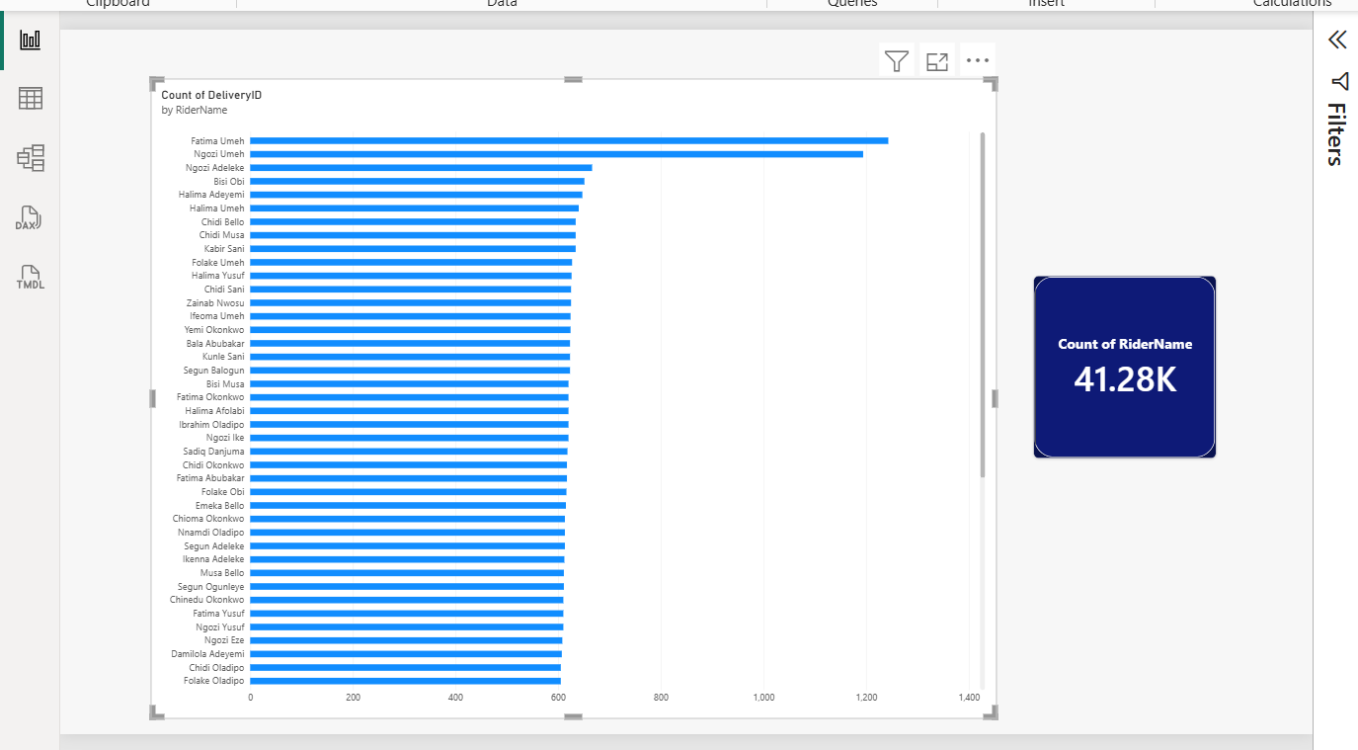
Watch this break
LIVE DEMO
WHAT YOU ARE SEEING
One table. Somebody joined all five SwiftRoute files together in Excel before importing, producing one wide table of 41,280 rows.
It loaded without a single error. Every visual builds. Nothing warns you.
“That is 41,280. We have 68 riders.” Let it sit for a moment before you say anything.
5
Notes:
RUN THIS LIVE from 7.2_demo_flat.pbix. Build the rider count card in front of them so they see it appear. Let the wrong number sit on screen without comment for a beat, then deliver the line.
Fallback file must already be open in a second window. If the live build fails twice, switch without apologising.
WHAT TO SAY AND DO (about five minutes):
"Here is a Power BI file somebody built. One table. They joined all five SwiftRoute files together in Excel first, which felt sensible, and imported the result: one wide table, forty-one thousand two hundred and eighty rows.
Watch me build the simplest possible visual. Card. Drag rider name in. Set it to count."
[Let the number appear.]
"That is forty-one thousand two hundred and eighty. We have sixty-eight riders."
[Pause. Say nothing for three seconds.]
"No error. No warning. No red. The file loaded perfectly, the visual built perfectly, and the answer is nonsense."
TIMING: 5 minutes including the live build.

Slide 6
The rider is not a rider. It is a rider-per-delivery.
DeliveryID
RiderID
RiderName
Hub
!
Chidi appears 617 times, once for every delivery he made in 2025.
D-000117
R-014
Chidi Okonkwo
Apapa
D-000118
R-022
Bisi Adeyemi
Ikeja
D-000119
R-014
Chidi Okonkwo
Apapa
Counting rows in that column does not count riders. It counts deliveries wearing rider names.
The number is not corrupt and it is not a bug. Power BI answered exactly the question you asked. You asked the wrong question.
D-000120
R-014
Chidi Okonkwo
Apapa
D-000121
R-041
Musa Bello
Lekki
D-000122
R-014
Chidi Okonkwo
Apapa
The grain changed. In a flat table the grain is one row per delivery, so every question it answers is a question about deliveries, whether you meant that or not.
6
Notes:
SLOW DOWN HERE. This is the explanatory heart of the topic.
THE CONTENT IN FULL: when you flatten, the rider's details stop being facts about a rider and become attributes of a delivery. Chidi Okafor does not appear once in this table. He appears 607 times, once per delivery. So counting that column counts deliveries, not riders.
Connect it explicitly back to Topic 7.1, where you made them say "one row per what". The flat table's grain is one row per delivery. Every question it answers is a delivery question.
WHAT TO SAY (about five minutes):
"Look at these six rows. Chidi Okafor, rider R-014, appears four times in six rows. Not because the data is corrupt. Because he made four of these six deliveries.
In the real table he appears six hundred and seven times.
So when you count that column, what are you counting? You are counting deliveries that happen to have his name written next to them. The rider stopped being a rider and became an attribute of a delivery.
Remember the word from last topic. Grain. One row per what. The grain of this table is one row per delivery, so every single question it can answer is a question about deliveries. Power BI did not make a mistake. It answered exactly what you asked."
TIMING: 5 minutes.

Slide 7
Duplication is only the visible cost
1
Wrong counts
2
Wrong averages
3
Impossible filters
Any distinct thing living in the fact table gets counted at delivery grain. Riders, routes, customers, all inflated.
Average rider tenure, weighted by how many deliveries each rider happened to make. Busy riders dominate a statistic that should treat every rider equally.
A slicer on Hub filters deliveries, not riders. You can never ask “how many riders in Apapa made no deliveries last week”, because those riders do not exist in this table at all.
The third one is the killer. A flat table cannot represent something that did not happen.
7
Notes:
COST 3 IS THE SOPHISTICATED POINT and it rewards the stronger trainees. It is also exactly the LEFT JOIN reasoning from Module 3: an inner join silently drops the inactive ones. Say that comparison out loud; it lands hard for anyone who understood that module.
WHAT TO SAY (about four minutes):
"Three costs, and only the first is obvious.
One, wrong counts. You have seen that. Anything distinct that lives in the fact table gets counted at delivery grain.
Two, wrong averages. Suppose you average rider tenure. Every rider is weighted by how many deliveries they happened to make, so your busiest rider counts six hundred times and your newest counts twice. That is not an average of riders. It is an average of deliveries that happens to mention tenure.
Three, and this is the one I want you to remember. A slicer on Hub filters deliveries, not riders. So you can never ask: how many riders in Apapa made no deliveries last week? Because a rider who made no deliveries has no rows. They do not exist in this table.
That is the same lesson as your joins in Module 3. An inner join silently drops the inactive ones and the row count still looks plausible."
TIMING: 4 minutes.

Slide 8
02
PART TWO
The fix
Separate events from things: fact and dimension
Draw the star and read every relationship
Ask the same question again and get 68
3
Notes:
WHAT TO SAY: "Part two. Now we do it properly, and you will see the number correct itself."
TIMING: 30 seconds.

Slide 9
Two kinds of table, two different jobs
▤ FACT TABLE
◎ DIMENSION TABLE
Records events. One row per thing that happened.
Long and narrow: many rows, few columns, mostly numbers and IDs. It grows every day.
Describes things. One row per thing that exists.
Short and wide: few rows, many descriptive columns, mostly text. It changes rarely.
swiftroute_deliveries
41,280 rows and growing
riders (68) · routes (24)
customers (310) · dates (365)
Rule of thumb: if you would filter or group BY it, it belongs in a dimension. If you would sum or count it, it belongs in the fact table.
9
Notes:
This is Topic 3.5 from Module 3 returning as practice rather than theory. The programme's prerequisite note says the star-schema concepts are applied here.
BEFORE YOU REVEAL: ask the room to classify the five SwiftRoute tables verbally. "Deliveries: fact or dimension? Riders? Routes? Customers? Dates?" They will get it right, which builds confidence, and it proves the Module 3 knowledge transferred.
WHAT TO SAY (about four minutes):
"Two kinds of table, and once you can tell them apart, modelling becomes mechanical.
A fact table records events. One row per thing that happened. It is long and narrow: millions of rows eventually, not many columns, mostly numbers and ID codes. It grows every single day.
A dimension table describes things. One row per thing that exists. Short and wide: sixty-eight rows, but lots of descriptive columns. It barely changes.
Here is the rule of thumb that settles almost every case. If you would filter or group BY it, it is a dimension. If you would sum or count it, it belongs in the fact table."
TIMING: 4 minutes.

Slide 10
The SwiftRoute star
riders
routes
RiderID
1
1
RouteID
RiderName
RouteName
Hub
RiderID
RouteID
DistanceKm
VehicleType
∗
swiftroute_deliveries
∗
ZoneTier
DeliveryID
RiderID · RouteID
CustomerID · DateKey
DeliveryFee · Status
∗
∗
customers_business
CustomerID
DateKey
dates
CustomerID
DateKey
BusinessName
1
1
MonthName
Sector
Quarter
IsWeekday
1 one side (dimension) ∗ many side (fact)
Four dimensions, one fact. Filters flow inward, from the outside of the star to the centre.
10
Notes:
THIS DIAGRAM IS THE VISUAL ANCHOR OF THE WHOLE MODULE. It reappears in 7.3 and 7.4. Trainees should recognise it instantly each time, so do not redraw or restyle it between decks.
Reading the notation: the teal dot marks the primary key in each dimension. The chip on each line names the column the relationship joins on. The 1 sits at the dimension end, the star at the fact end.
WHAT TO SAY (about five minutes):
"This is the shape you are building. It is called a star schema, and you can see why.
The fact table sits in the middle. Deliveries. Every row is one event that happened.
Around it, four dimensions. Riders, routes, customers, dates. Each one describes a kind of thing that exists.
Look at the label on each line. That is the column the relationship joins on. RiderID, RouteID, CustomerID, DateKey. Each one appears once in the dimension, as its primary key, and many times in the fact table, as a foreign key.
Now watch the direction, because this is the part people get wrong."
[Trace with your cursor from a dimension into the fact table.]
"I click Apapa in a hub slicer. The filter starts in riders, travels down the relationship, crosses into deliveries, and only Apapa riders' deliveries survive. Filters flow downhill, from the one side to the many side. From the outside of the star into the centre.
Say it back to me: from the one side to the many side."
TIMING: 5 minutes.

Slide 11
One rider, many deliveries
ONE side · riders
MANY side · swiftroute_deliveries
R-014 Chidi Okafor
D-000117
R-014
1
∗
D-000118
R-022
R-022 Bisi Adeyemi
D-000119
R-014
R-041 Musa Bello
D-000120
R-041
D-000121
R-014
D-000122
R-022
The ONE side must hold each key exactly once. The MANY side may repeat it freely. That is not duplication, that is the whole idea.
11
Notes:
PREDICT-THEN-RUN. This is Module 3's signature technique, and naming it every time is what makes it transfer. Before building the relationship in the demo, ask the room to state on paper how many delivery rows will show for Chidi Okafor, and why. Then run it and reconcile.
WHAT TO SAY (about four minutes):
"On the left, riders. Three rows, three different riders. Each Rider ID appears exactly once. That is your primary key from Module 3, and Power BI will refuse the relationship, or quietly degrade it, if that is not true.
On the right, deliveries. Look at R-014. It appears three times in six rows. Is that duplication? No. That is the point. Each delivery is pointing back at the rider who made it.
So: the one side must hold each key exactly once. The many side may repeat it as often as it likes.
Before I build this, write down on paper: how many delivery rows do you expect for Chidi Okafor? You did exactly this with joins in Module 3. Same move."
TIMING: 4 minutes.

Slide 12
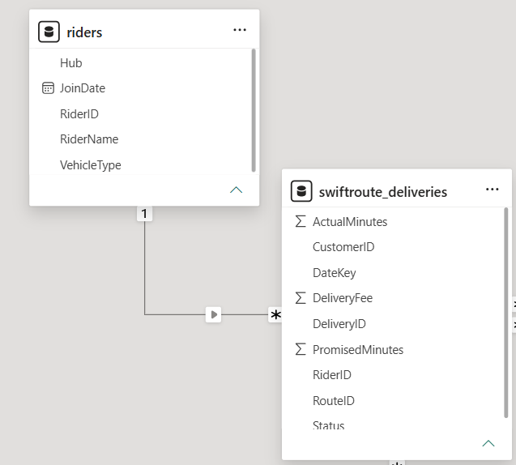
Drawing a relationship in Model view
1
Open Model view
2
Drag key to key
3
Confirm cardinality
4
Check the filter arrow
READ, DO NOT CLICK THROUGH
Drag RiderID from riders onto RiderID in deliveries. Power BI infers the cardinality and shows it.
Read what it inferred. An unexpected many-to-many is almost always a data quality problem in the dimension, not a modelling decision.
The Create relationship dialogue: riders.RiderID to
swiftroute_deliveries.RiderID, One to many, Single direction
12
Notes:
DEMO LIVE. Deliberately drag the wrong direction first, show that Power BI still resolves it correctly, then explain that this convenience is exactly why people never learn which side is which.
WHAT TO SAY (about two minutes):
"Model view. I take Rider ID from the riders table and I drag it onto Rider ID in deliveries. A line appears.
Now, Power BI has just made a decision on your behalf. It has looked at the data, worked out which side is unique, and set the cardinality. Most people click straight past this dialogue.
Read it. It should say one to many, with the one on riders. If it says many to many, do not shrug and continue: that means your dimension table has duplicate keys, and you have a data problem to fix upstream."
TIMING: 2 minutes.

Slide 13
Read every relationship before you trust it
⇄
Cardinality
Should be one to many, with the “one” on the dimension. Many-to-many means your dimension has duplicate keys.
→
Cross-filter direction
Should be Single, flowing from dimension to fact. “Both” is available and is almost always the wrong choice for a beginner.
◌
Active or inactive
A dotted line means the relationship exists but is not being used. Power BI allows only one active path between two tables.
Ninety percent of “my numbers are wrong” problems in Power BI are one of these three. Photograph this slide.
13
Notes:
TELL THEM TO PHOTOGRAPH THIS SLIDE. It is the diagnostic checklist they will use for the rest of their careers, and it is the first question you ask in the lab when a hand goes up: "which of the three did you check?"
WHAT TO SAY (about three minutes):
"Three things to check on every relationship you ever build.
Cardinality. One to many, with the one on the dimension side. If it says many to many, stop: your dimension has duplicate keys.
Cross-filter direction. Single, flowing from the dimension into the fact. Both is available. It is almost always wrong, and I will show you why on the next slide.
Active or inactive. If the line is dotted, the relationship exists but is not being used. Power BI only allows one active path between any two tables.
Photograph this. When something in your report is wrong, this is where you start."
TIMING: 3 minutes.

Slide 14
Both directions feels helpful. It is not.
SINGLE · filters flow one way
BOTH · filters can travel back up
riders
routes
riders
routes
deliveries
deliveries
Setting cross-filter to Both lets filters travel back up from the fact into the dimension, then across into other dimensions. It solves the problem you were poking at and creates ambiguity everywhere else, because Power BI can now reach the same table by more than one path and has to pick one.
The symptom appears weeks later, in a different visual, as a number that is quietly wrong.
14
Notes:
THIS IS GENUINELY ADVANCED and you are giving them a rule rather than the full theory. Be honest about that, because pretending otherwise damages trust.
WHAT TO SAY (about three minutes):
"There is a setting called cross-filter direction, and it has an option called Both. It looks helpful. It is a trap.
Single means filters flow one way: from the dimension into the fact. Both means they can also travel back up out of the fact table, and then across into a different dimension.
Here is why that hurts. Once filters can travel both ways, Power BI can often reach the same table by more than one route, and it has to pick one. You will not notice. The visual you were fixing works. Then three weeks later a completely different chart is quietly wrong and you have no idea why.
I am giving you a rule here, not the reasoning, because the reasoning takes a week. Leave it on Single. If you think you need Both, you probably need a different measure, which is the next topic."
TIMING: 3 minutes.

Slide 15
Every model needs a date table. Yours already has one.
dates.csv · 365 rows
It looks redundant, because deliveries already has a date column. It is not.
A dimension table for dates is what lets you say “compare this month with the same month last year” in a single measure. Without it, every time comparison becomes a hand-built filter, and the CALCULATE example in the next topic does not work at all.
Year · Quarter · MonthName · WeekNumber · IsWeekday
✓
Table tools › Mark as date table › choose DateKey.
Do this before you write any time-based measure.
In about forty minutes you will write a measure that compares month on month, and it will be one line because of this table.
15
Notes:
TRAINEES RESIST THIS because it feels like extra work for no visible gain. The gain arrives in the next topic, so flag it forward explicitly and they will accept it.
WHAT TO SAY (about three minutes):
"Fifth table. Dates. Three hundred and sixty-five rows, one per day, with year, quarter, month name, week number and a weekday flag.
And every cohort someone asks: why? Deliveries already has a date column.
Here is why. That date column is a single value on a single row. It cannot tell you what quarter it belongs to, or what the same month last year was. A date dimension can, because those are columns you can group and filter by.
Concretely: in the next topic you will write a measure comparing this month with last month. With this table it is one line. Without it, it is a hand-built filter every single time, and it breaks the moment your dates change.
One thing you must do: Table tools, Mark as date table, choose DateKey. Do it before you write any time measure."
TIMING: 3 minutes.

Slide 16
The same question, asked of a proper model
FLAT TABLE
STAR SCHEMA
41,280
68
Correct answer to a question nobody asked
The riders dimension has 68 rows, so counting it counts riders
Notice what did not change. The data is identical. The visual is identical. The only thing that changed is which table the count is drawn from, and that was decided by the model, not by the chart.
The model is where correctness lives. The chart just shows you what the model believes.
16
Notes:
CLOSE THE LOOP opened on the hook slide. Say the pull line word for word; it is the sentence you want trainees repeating in the capstone.
Rebuild live if time allows, otherwise switch to the fallback 7.2_demo_star.pbix.
WHAT TO SAY (about four minutes):
"Same question. Count the riders.
On the flat table: forty-one thousand, two hundred and eighty. And I want to be precise about this, because it matters. That is not a bug. That is a completely correct answer to a question nobody asked.
On the star schema: sixty-eight.
Now notice what did not change. Same data. Same visual. Same field dragged into the same card. The only thing that changed is which table the count is drawn from, and that was decided by the model, not by the chart.
So here is the sentence I want you to leave with. The model is where correctness lives. The chart just shows you what the model believes."
TIMING: 4 minutes.

Slide 17
YOUR TURN
Build the star
12 min
THE TASK
Open 7.2_practice_unlinked.pbix. All five SwiftRoute tables are loaded with no relationships. Build all four, set every cross-filter direction to Single, and mark dates as the date table.
EXPECTED OUTPUT
Four solid lines in Model view, no dotted lines, every relationship reading One to many with the “one” on the dimension. A card counting riders returns 68. A card counting routes returns 24.
Predict first. Write down what a count of customers will return before you build it.
17
Notes:
THE PLANTED FAULT: one relationship will refuse to build. routes_raw.csv has a trailing space on one RouteID, which Topic 7.1 told them to trim and which many will not have. This is deliberate, per the error-driven learning method.
Let them find it. If nobody has after eight minutes, prompt with "check your keys, not your relationships". Do not give the answer; the next slide does.
WHAT TO DO: walk the room. Do not answer from the front. Expected answer for the prediction: customers returns 310.
TIMING: 12 minutes.

Slide 18
Why the routes relationship refused
In routes.csv
In deliveries.csv
“LAG-07·”
“LAG-07”
trailing space, invisible on screen
clean
To you these are the same route. To Power BI they are two different text values, so the relationship either fails to match or matches only some rows. Nothing turns red. The join produces blanks, and you read the blanks as missing data.
↑
The fix is upstream, in Power Query: Transform › Format › Trim.
Not in the model, and never by editing the source file by hand.
18
Notes:
SAY "THE FIX IS UPSTREAM" and connect it back to Topic 7.1's golden rule of load order. This is the payoff for having taught clean-first, and it is the moment trainees understand why you insisted on it.
WHAT TO SAY (about three minutes):
"Anyone whose routes relationship refused, or produced blanks: here is why.
In routes, that route code has a trailing space. LAG-07 space. In deliveries it does not. To you, reading them on screen, they are identical. To Power BI they are two different strings, so they do not match.
And notice the failure mode. Nothing turned red. No error appeared. The relationship built, produced blanks, and you interpreted the blanks as missing data.
The fix is not in the model. It is upstream, in Power Query: Transform, Format, Trim. And this is exactly why I made you clean first in the last topic. Fix it at the source and every relationship downstream just works."
TIMING: 3 minutes.

Slide 19
The honest caveat
⚖
A single table is not always wrong. If you have one source, no dimensions worth describing separately, no time intelligence and no counts of distinct things, a flat table is simpler, and simpler is a real virtue. Plenty of good reports are one table.
The claim in this topic is narrower, and it is the one your outcome asks you to explain: a flat table is the wrong design when you need to count or filter by things rather than events. Know which situation you are in, and be able to say why.
A trainee who says “flat tables are always bad” has learned a slogan, not a skill. This nuance is fair game in the formative check.
19
Notes:
DO NOT SKIP THIS. The programme's standard is that trainees can justify choices, not recite rules. A trainee who leaves believing "flat tables are always bad" has memorised a slogan and will apply it wrongly in their capstone.
WHAT TO SAY (about three minutes):
"Before we finish, let me be fair to the flat table, because I have spent forty minutes attacking it.
A single table is not always wrong. If you have one source, nothing worth describing separately, no time comparisons and no counting of distinct things, then one table is simpler. And simpler is a real virtue, not a compromise. Plenty of perfectly good reports are one table.
The claim I am actually making is narrower. A flat table is the wrong design when you need to count or filter by things rather than events.
Know which situation you are in, and be able to say why. That is the outcome. Not 'flat tables are bad'."
TIMING: 3 minutes.

Slide 20
Topic Recap
✓
Build a data model with correct one-to-many relationships, and check cardinality, direction and active state.
✓
Explain why a flat single table is often the wrong design, with a worked failure you watched produce a plausible wrong number.
✓
Fix a broken relationship upstream in Power Query rather than patching it in the model.
You have seen a chart that was beautifully labelled and completely wrong. Remember how that felt.
20
Notes:
Restating outcomes as achievements is required by the deck anatomy in the Content Creator Guide.
WHAT TO SAY (about two minutes):
"Three things you can do now that you could not an hour ago.
You can build a data model with correct relationships, and you know the three things to check on every one.
You can explain why a flat table is often wrong, and you can explain it from something you watched rather than something you were told.
And you can fix a broken relationship at its source instead of patching around it.
One last thing. You watched a chart today that had a title, an axis label and a legend, and was completely wrong. Remember how that felt. That feeling is the most valuable thing you will take out of this module."
TIMING: 2 minutes.

Slide 21
What is Next
TOPIC 7.3
IN THE LAB
ON PUBLICA.ACADEMY
ƒ
▣
?
The model knows the structure. Now you teach it to calculate. Three DAX measures cover most real dashboards.
Repair a model with three deliberate faults: a bidirectional relationship, a many-to-many caused by duplicate keys, and an inactive relationship nobody noticed.
Practice questions on cardinality and filter direction, using the SwiftRoute star.
21
Notes:
END ON THE 7.3 TEASER. Trainees respond to the promise that three measures will cover most of what they need.
WHAT TO SAY (about one minute):
"Straight into 7.3. Your model now knows how the tables relate. What it cannot do yet is calculate anything beyond a row count.
In the next topic you learn three DAX measures. Only three. An aggregation, a ratio, and a time comparison. Between them they cover the substantial majority of real operational dashboards, and I will show you how to verify each one against the source data so you never ship a number you cannot defend."
TIMING: 1 minute.

